Slide 1
dubstep
wub wub wub wub
and post subcultural analysis
Dan Conway
guiheadz@gmail.com

Slide 2
what we’ll cover today
History
  Where did it come from?
What is happening right now?
  Popularity in US
  Backlash by originators
  Moral panic by mainstream
Analytical frameworks
  50s to now (deviancy > socio-economic factors > post-marxism > post-modernism > post-subcultural analysis)
Why is it happening?
  Identity
  Commercial forces
  Commodification
How is this similar to everything that has happened before.
How is it different?

Slide 3
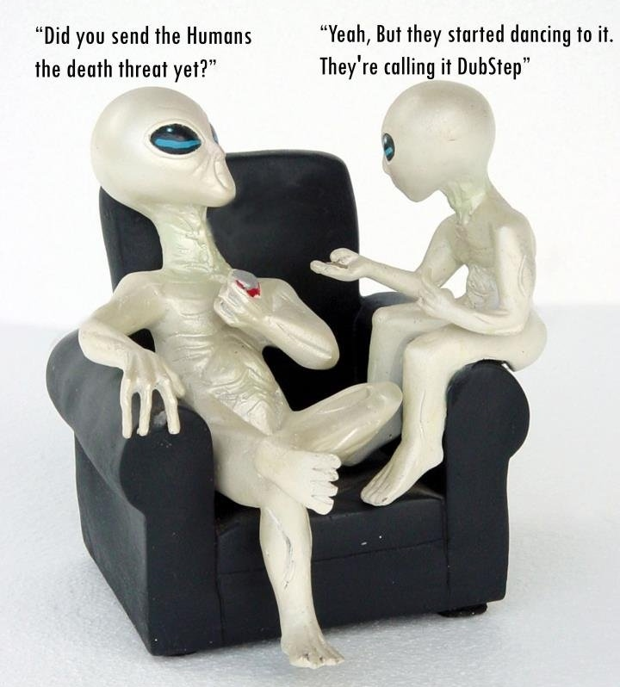

Slide 4
history
Garage
Dubstep
UK Success
US success
Brostep

Slide 5
“Garage started in North London, around 96-97, I was sixteen, seventeen. It died 2001 when it got commercialised. The tunes were only good for a week, it was more like quantity over quality, it became boring, not very inspirational”.
- Fabio, FreakFM, Stoke Newington

Slide 6
garage vs. dubstep
Style differences.
  Garage = cool trainers and gold chains.
  Dubstep = unisex hoodies.
    Not glam
    Associations of street / crime.
Mood differences.
Drug differences.
Socio-economic differences?
Sex role-play differences.

Slide 7
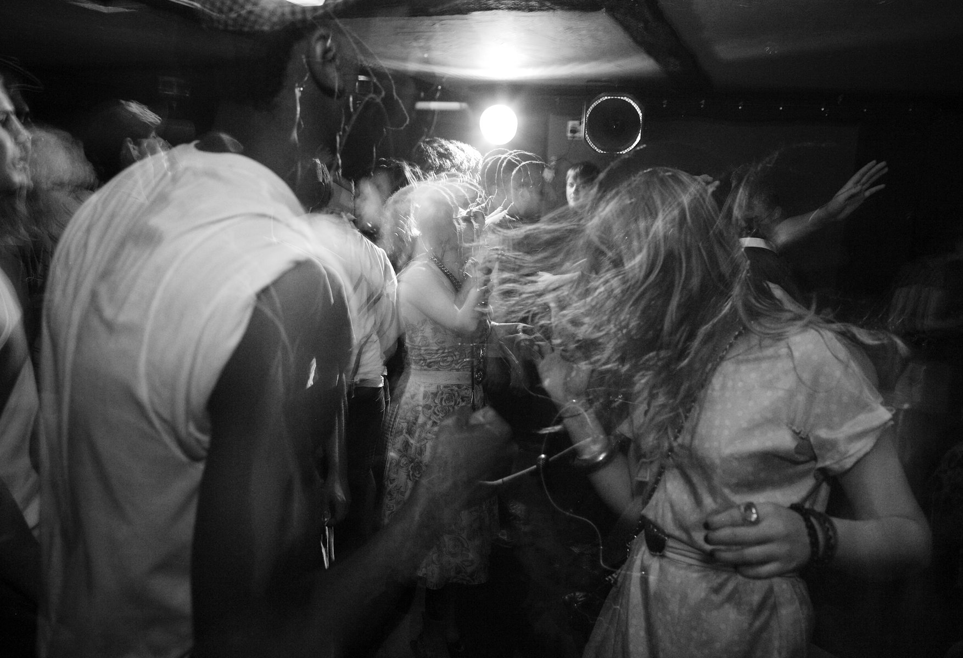
Notes:
From tiny Clubs in the UK

Slide 8
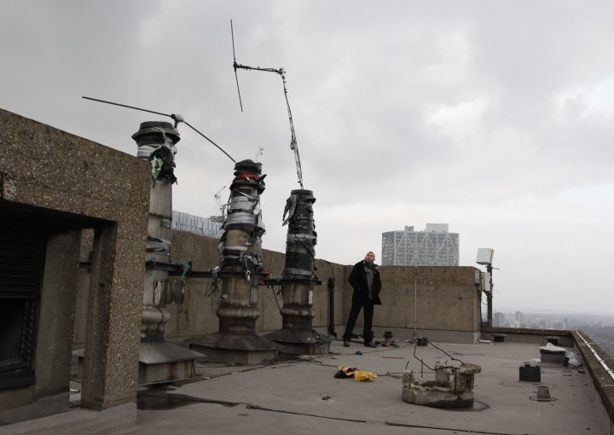

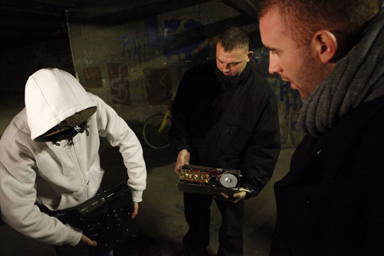

pirate radio

Slide 9
conditions for innovation
3 pre-requisites to innovation
A culture that contains symbolic rules.
A person/group who brings novelty to the symbolic domain.
A field of experts who recognise and validate the innovation.
- Csikszentmihalyi,1997.

Slide 10
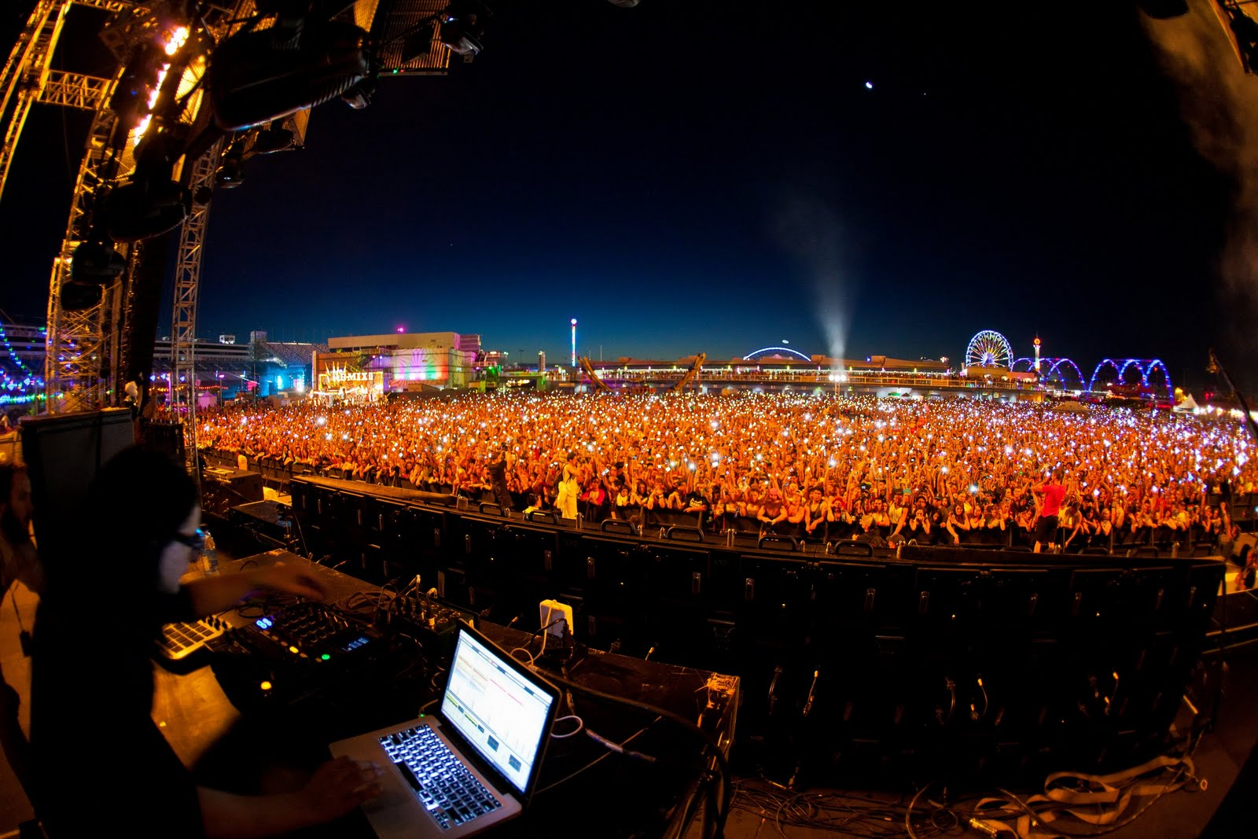
Notes:
To massive arenas in the US. POPULARITY

Slide 11
Scary monsters and nice sprites
http://www.youtube.com/watch?v=WSeNSzJ2-Jw&feature=youtu.be

Slide 12
blowback - dubstep hatred
Brostep / mid-range crack / bruvstep
“ Well brostep by definition is designed to be easily accessible rave/party music. The emphasis is on catchy/poppy melodies and violent over-the-top mid-range sounds. Real dubstep is pretty much the exact opposite. There is a dark, almost brooding sound, and layers of musical complexity that needs to be heard several times to be truly appreciated. Its definitely a sound that grows on you and many have described it as an "acquired taste".
- Some random dude on Reddit.
Notes:
And… the BACKLASH

Slide 13
where we are now…
http://www.break.com/index/cc-test-2375516/
Notes:
MORAL PANIC

Slide 14
your thoughts?
What is this video saying about Dubstep?

Slide 15
moral panic
This music makes people violent.
This music unleashes destruction (buildings collapsing).
‘This new dubstep’ ‘That’s the dubstep man’. Language is wrong – indicates not familiar with actual culture.
Othering.
‘Is that music?’ ‘…its so loud and disorientating.’ Authenticity?
You can’t ‘get it’ if your too old.
Makes people respond in a certain way – involuntarily. Ie: bypassing social norms – letting basic/unhealthy/animal instincts take over.
Music is taken to extremes until it’s silly.
Unhealthy (nose is bleeding) and extreme like earlier claims about masturbation. Un-natural.
We feel smug because we know how silly this is. Sub-cultural capital.
If you had never really experienced dubstep but were young and curious this might make you MORE likely to go out and find it.

Slide 16
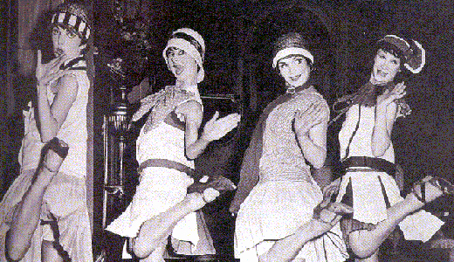
more moral panic…
1920s – gender norms
being upset by women in ‘flapper’ culture.
Elvis and youth delinquiency.
Hippy culture and the Manson murders.
Anna Woods and rave culture in Sydney.
Video games and Columbine shooting.
Kellyville ‘Bush Doofs’.

Slide 17
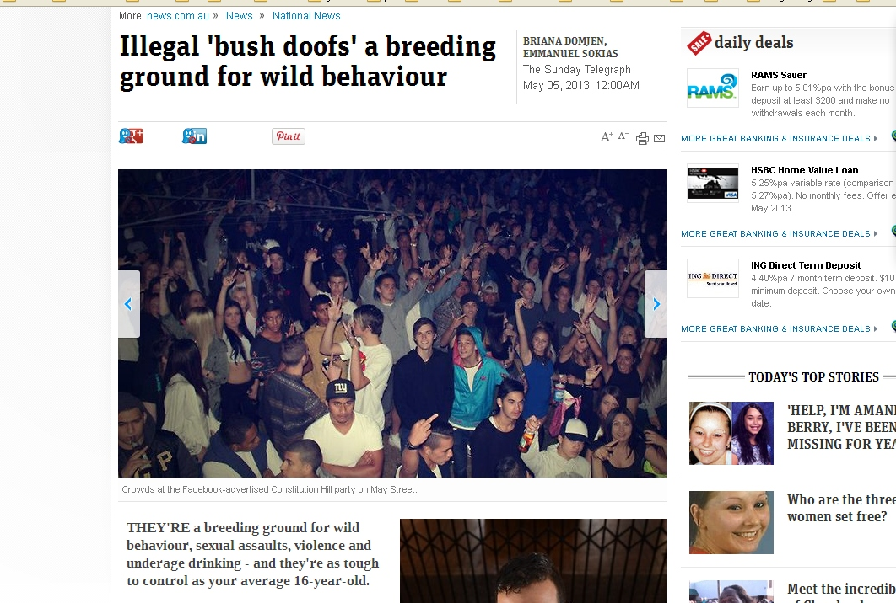

Slide 18
moral panic effects…
Media outrage actually FUELS youth culture.
Deviancy models (50s and 60s) did not take into account the market and media. And nowadays media is so omnipresent!

Slide 19
analysis
1950s - 60s Deviance from social norms
1970s CCCS and Neo-Marxism
1980s – 90s Postmodernism
Now Stay tuned…
Notes:
So these have been some major condeptual frameworks used for discussing youth culture.

Slide 20
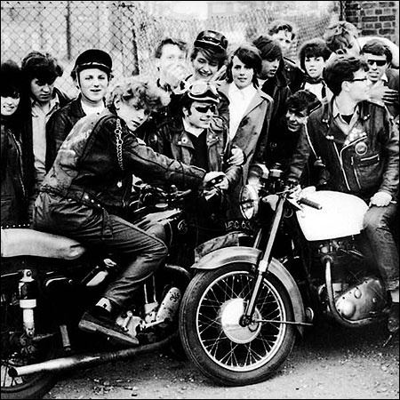
1950s
DEVIANCE!!!!
Youth culture seen as the result of social classes that had not taken on American values sufficiently.
Mass culture inherently corrupting – comics, movies, music, books.
Social disorganization.
  no women
  class focus only.
  Work, home, street.
Didn’t talk about new media markets. Or when they did – they viewed media as repressive NOT appetitive.

Slide 21
1960s
Labeling Theory - Lemert, Becker et al.
Deviancy is defined by what the majority calls it.
People labeled as deviants often self-define via this label.
Identity is formed through interaction with others.
Majority use this labelling as a form of control.
Seperates labelling from behaviour.
A little bit more reflexive.
Starts to look at Media’s role in defining culture.

Slide 22
1970s
Centre for Contemporary Cultural Studies (CCCS) – University of Birmingham.
Influenced by American youth culture studies.
Very based in place.
Looking at street gangs.
Structuralist, neo-Marxist: youth rebellion was the result of massive fracturing of working class.
Not very good at analyzing middle class rebellion – eg: Hippies / heavy metal.
Still wasn’t looking at the role of women. Ffs.

Slide 23
1980s and 90s - postmodernism
Originally a philosophy of art.
All frameworks for analysis come from somewhere and therefore have assumptions and power (structural) biases.
Everything can be valued.
Logic and rationalism are optional (and contain their own biases).
Focus is more on consumption and style. Sites of study have moved from the streets to the shopping mall.

Slide 24
1980s and 90s - postmodernism
Developing further the ideas of the CCCS (Birmingham) in the 1970s.
Subcultures CANNOT resist – only offer the illusion of it – in contradiction to the CCCS outlook – thus opposition is purely symbolic and cultures largely hedonistic.
Ideas circulate and collide in complex ways – and culture and subculture exchange ideas and values – osmotic.
Notes:
MUGGLETON

Slide 25
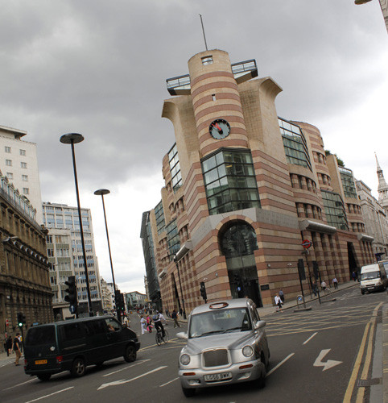
postmodernism

Slide 26
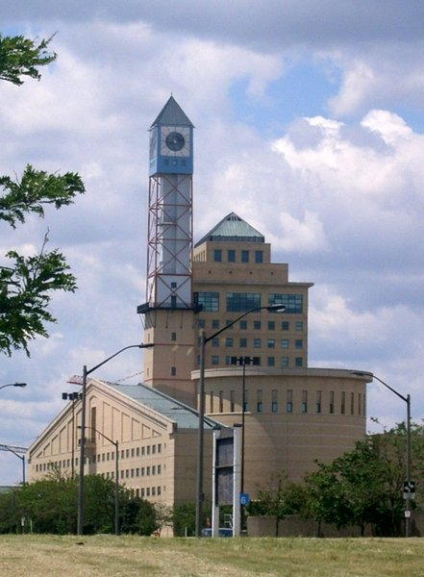
oh god… the horror…

Slide 27

poor Ben…

Slide 28


Slide 29
postmodernism
Focus on identity in any form – so now sites are shopping malls, nightclubs, anywhere.
Less focused on collectivism than individualism.
Bricolage approach (eg: Punk’s safety pin) – identities can cross class, gender, cultural divides. Multiple truths and narratives – can be contradictory.
Fluidity of cultural boundaries and identity.
Mafessoli, 1996

Slide 30
now… post-subculture
No fixed subcultures. ‘Neo-tribes’.
Media is now an important resource for tribes (the internet etc…).
Create lifestyles where many different threads of culture can be woven together.
Identity chosen through consumption (instead of – in postwar analysis) class and upbringing.
But class interpretations still hanging in there.
Despite naïve optimism of postmodern analysis – people still subject to power structures. Not as free…
Notes:
Frohlich , esp p45

Slide 31
post-subculture
Structure still DOES influence – which makes the idea of fluidity difficult to maintain.
Suggests that mainstream culture (to which subcultures define themselves oppositionally) has changed, become less stratified. Ideas circulate and collide in complex ways – and culture and subculture exchange ideas and values – osmotic.
Also postmodernism – with its emphasis on fragmentation and individualism – can miss the whole picture of belonging to a group.
Notes:
Dedman

Slide 32
post-subculture
Subcultures CANNOT resist – only offer the illusion of it – in contradiction to the CCCS outlook.
But new youth formations CAN be intensely political (eg: Occupy).
Ideas circulate and collide in complex ways – and culture and subculture exchange ideas and values – osmotic.
Ideology AND hedonism.
And finally, a focus on women.
Notes:
Muggleton

Slide 33
so what are we looking at?
  ‘Scenes’ (Straw, 1991).
  ‘Tribes’ (Clarke, 1997).
  ‘Neo-tribes’ (Maffesoli, 1996).
  ‘Collective lifestyle statements’ (Chaney, 2004).
  ‘Channels’ or ‘subchannels’ (Singh, 2000).
  ‘Temporary substream networks’ (Weinzierl, 2000).
  ‘Clubcultures’ (Redhead 1997).
All are slightly different frameworks for examining similar phenomena and are therefore sometimes used interchangeably.

Slide 34
why the backlash?
When sub-cultural music becomes mainstream – those who have invested in it are upset because the music originally defined itself in OPPOSITION to mainstream – therefore they loose their IDENTITY! The betrayal is absolute and incites total animosity and venom.
When sub-cultures reach the mainstream they become frozen.!!!
Inherant tension between band and fans – the band may want to change their sound – the fans want the band to stay the same so that they can claim exclusive ownership. ‘I liked them before they were famous’ and ‘I liked your old stuff better than your new stuff’.
Cultural capital – defends position by othering those who are more recent fans. Claims of authenticity.
Moore, 2005

Slide 35
A little bit of psychology...

Slide 36
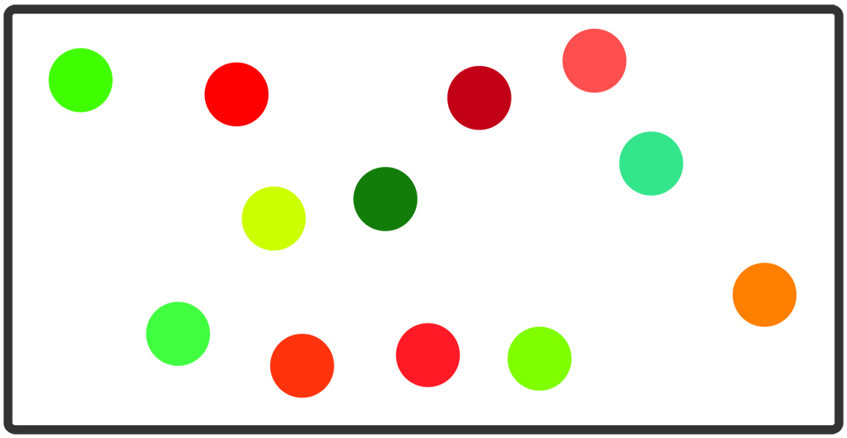
the outgroup homogeneity effect

Slide 37
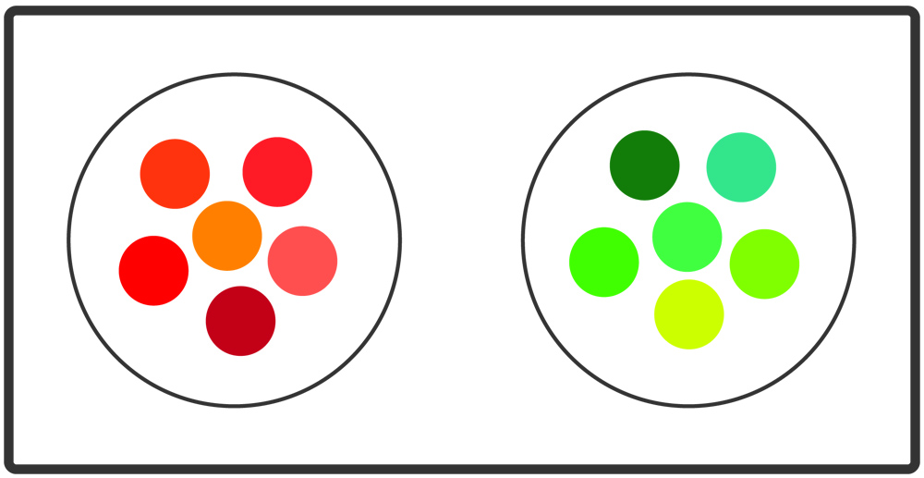

Slide 38
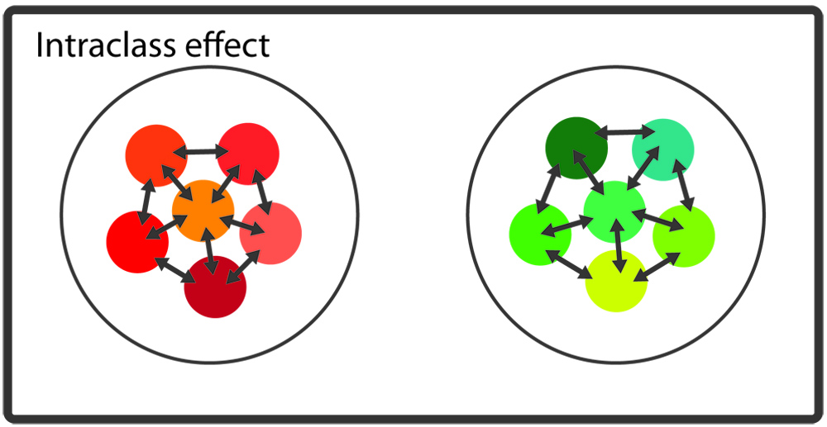

Slide 39
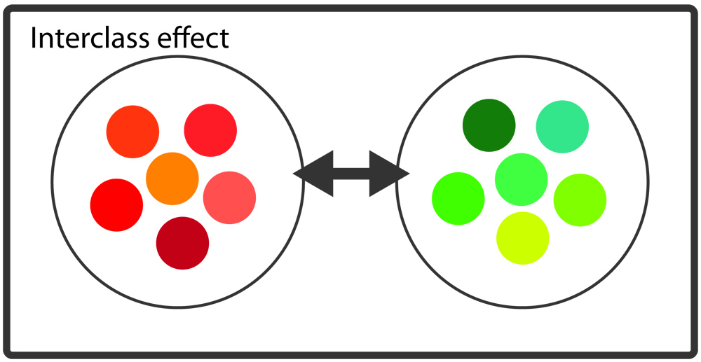

Slide 40
but…
If an idea was genuinely subversive or disruptive – why should it be any less so when more people do it?
Perhaps is actually the acid test of the dangerousness of an idea – is it still dangerous when everybody does it.
      - Muggleton, 2000.

Slide 41
multiple things going on…
So back to the dubstep comedy sketch.
Elements of moral panic.
But also the media portrayal creates interest – makes it seem dangerous, edgy, adults don’t understand.
This accumulation of cultural capital is acknowledged by the culture industries – who want a piece of it and will pay for it because they know…
They can use this image (of edge) to sell back to the kids (commodities, events, media, fashion, music, entire lifestyles.)
Furthermore consumers are very aware when they’re being marketed to – so ‘authentic’ people – brand leaders are very important.

Slide 42
co-option and the marketing of rebellion.
Cool hunters are highly paid young people who seek out latest fads and ideas…
SUB-CULTURAL CAPITAL! In-group hierarchies that distinguish between the ‘hip’ and the ‘posers’. Based on perceived authenticity and distance from mainstream culture.
But this same SUB-CULTURAL CAPITAL CAN ALSO BE USED TO MARKET TO OUTSIDERS!!!
But only for a little while – eventually anything that has been appropriated by the mainstream will no longer seem cool or edgy. Loss of authenticity.
Moore, 2005

Slide 43
“Politics, man. If you're hanging onto a rising balloon, you're presented with a difficult decision - let go before it's too late or hang on and keep getting higher, posing the question: how long can you keep a grip on the rope? They're selling hippie wigs in Woolworths, man. The greatest decade in the history of mankind is over. And as Presuming Ed here has so consistently pointed out, we have failed to paint it black.
- Danny
in ‘Withnail and I’

Slide 44
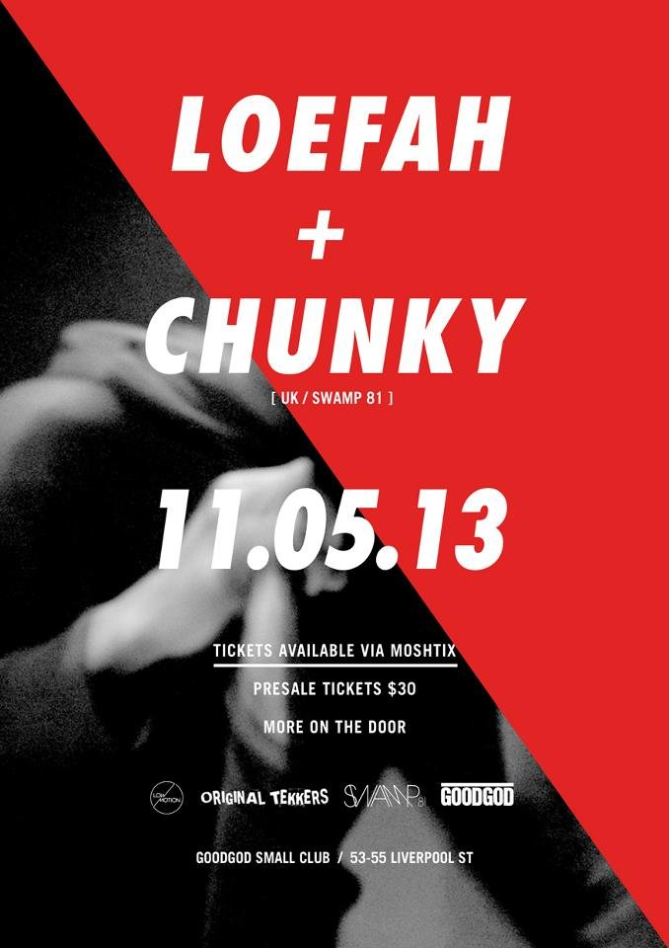
an excursion?
Facebook event:
http://www.facebook.com/events/128006500718533/
One of the pioneers of dubstep, Loefah along with his partners, Mala and Coki started the now infamous DMZ brand. As "dubstep" grew further and further from its roots and became increasingly commercial, Loefah turned his attention to an emergent new hive of creativity to create the label, Swamp 81. with a string of releases from the likes of Addison Groove, Ramadanman, Boddika and Falty DL Swamp81 is dedicated to the promotion of subcultural bass music with releases that display a like minded dedication to weighty electronic music and that is what has made the ripples world wide for this label.

Slide 45
references
Dedman, T., Agency in UK hip-hop and grime youth subcultures - peripherals and purists. Journal of Youth Studies, 2011. 14(5): p. 507-522.
Moore, R., Alternative to what? Subcultural capital and the commercialization of a music scene. Deviant Behavior, 2005. 26(3): p. 229-252.
Muggleton, D. and R. Weinzierl, The post-subcultures reader. 2003: Berg.
Csikszentmihalyi, M., Creativity: Flow and the Psychology of Discovery and Invention. 2009: HarperCollins e-books.
http://www.vulture.com/2012/01/why-does-america-love-skrillex.html
Thanks to Powerpoint for the colour scheme. Picked as a fitting accompaniment to the material on Post-Modernism and the 90s. Oh god, the horror.

Slide 46
and more interesting stuff…
A nice little potted history:
http://www.loso.estranky.sk/clanky/history.html
More backstory, with links to docos:
http://www.keepalbanyboring.com/2011/oh-dubstep-who-really-birthed-you/
Reddit Communities:
http://www.reddit.com/r/Brostep/
http://www.reddit.com/r/dubstep
http://www.reddit.com/r/realdubstep

